Slide 1
E-commerce Performance Analysis
Business Insights & Strategic Recommendations
Presenter: Zulfiqar Ali, Aspiring Data Analyst

Slide 2
State of the Marketplace
Identified Critical Churn Drivers: Discovered a 52% customer churn rate (2017-2018) and a 0% retention cohort, identifying a massive influx of "one-time buyers" as the root cause.
Forecasted Seller Risk: Revealed that 17% of active sellers are currently "slipping" into inactivity, threatening to drive the platform's overall inactivity rate beyond 34%.
Highlighted Revenue Opportunities: Pinpointed "Health & Beauty“ and Lifestyle products as the highest-demand product category, providing a clear target for marketing campaigns.

Slide 3
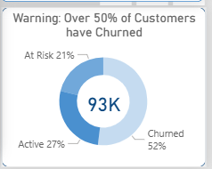
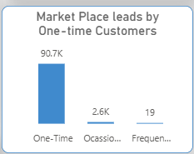
Diagnosing the 52% Churn Rate
The spike in churn is not distributed evenly across our user base.
It is driven heavily by an influx of 91,000 "One-Time Buyers.“
These users make a single purchase (frequently in the Health & Beauty category) and
never return to the platform.

Slide 4
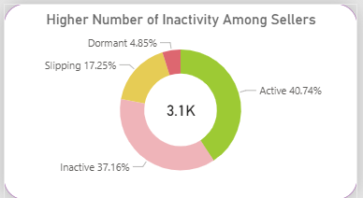
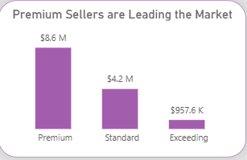
Seller Performance & Health Analysis
Strong Baseline Revenue: Our network of 3.1K sellers successfully generated $13.83M in GMV across 97.5K orders, maintaining a healthy Average Order Value (AOV) of $142.
Premium & Silver Dominance: Premium sellers are the primary revenue drivers ($8.6M GMV), while the vast majority of our overall seller base (75%) currently sits in the Silver tier.
Critical Inactivity Risk: Less than half of our marketplace is actively trading. Only 40.7% of sellers are currently active, while a massive 37.1% remain entirely inactive.
Immediate Recovery Opportunity: With 17.25% of our sellers categorized as 'Slipping,' launching targeted re-engagement campaigns for this specific group represents our fastest path to recovering order consistency.

Slide 5
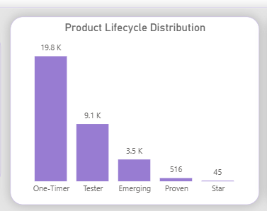
Product Performance & Lifecycle Analysis
Explosive Late-Term Growth: The platform successfully drove $13.6M in Total GMV across 114K products sold, highlighted by a massive, exponential spike in order volume and revenue culminating in August 2018.
Health & Lifestyle Dominate Revenue: Top-line revenue is heavily concentrated in premium categories. Health & Beauty ($1.3M) and Lifestyle Categories($1.2M) are our highest-grossing segments, supporting a strong overall Average Selling Price of $120.
The "One-Timer" Bottleneck: Despite solid top-line sales and a healthy 3.98 average rating, our Product Lifecycle Distribution reveals a major retention flaw: 19.8K products never progress past a single purchase.
Strategic Opportunity: Only a tiny fraction of our inventory reaches "Proven" (516)
or "Star" (45) status. To reduce our 52% customer churn, we must shift strategy to drive repeat purchases for these high-volume "One-Timer" items through strategic bundling or
post-purchase marketing.

Slide 6
Recommended Action Plan
Marketing Team: Launch a targeted "30-Day Win-Back" email campaign specifically for the 91K one-time buyers, offering a discount on their second purchase.
Account Management: Initiate automated check-in emails for the 17.25% 'Slipping' sellers to encourage new inventory uploads.
Sales/Web Team: Implement "Frequently Bought Together" bundle discounts at checkout based on the Market Basket Analysis.

